Slide 1
Object detection review

Slide 2
Objectives
Localize objects - bounding box (2D / 3D)
Classification- multiple-classes
Recognize objects at vastly different scales
Multi-task: key-point detection.
High mean average precision. Precision vs Recall.
Computational efficiency.

Slide 3
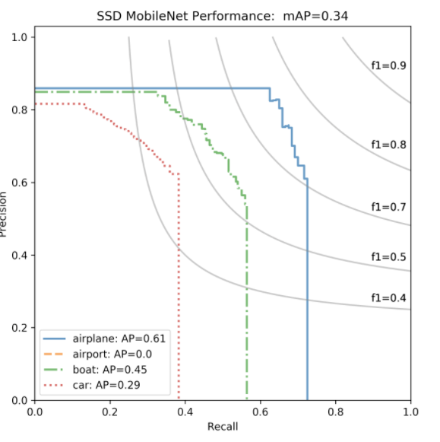
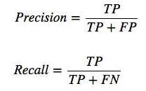
Mean Average Presicion - mAP
Precision measures how accurate is your predictions. The percentage of your predictions are correct.
Recall measure how good you find all the positives.
mAP is defined as area below the precision-recall curve.

Slide 4
Overview
Scale pyramid
Two stage detectors:
R-CNN: Mask-R-CNN, Fast-R-CNN, Faster-R-CNN
One stage detectors:
Detection heads: SSD, FPN, YOLO.
Anchor based vs Anchor free.

Slide 5
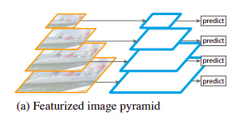
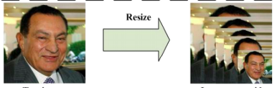
Scale pyramid
Input image is scaled multiple times, to detect wide range of objects size.
Nms between all predictions.
Example, MTCNN for face detection.
High inference time.

Slide 6
Two-Stage detectors
Two stage detectors include basicly 3 main parts:
CNN backbone
Region-Of-Interest (ROI) proposals
Classification / Regression heads

Slide 7
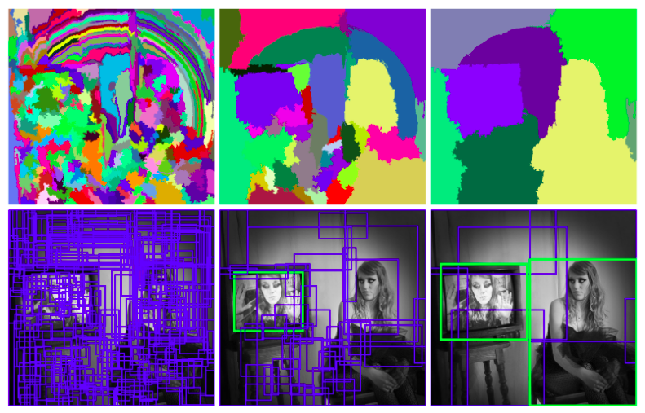
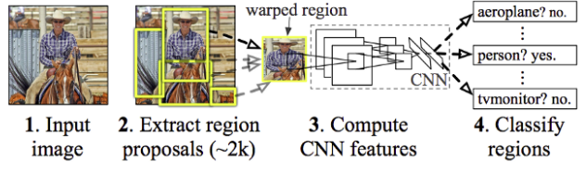
Two-Stage detectors
R-CNN
Region proposal of 2000 regions using Selective search SS.
SS is and iterative algorithm to segment the image to regions, very greedy!.
Far from real-time around 47 seconds for each image!!.
SS is a fixed algorithm, no learning is happening.

Slide 8
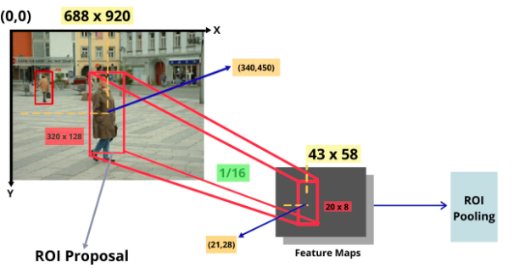
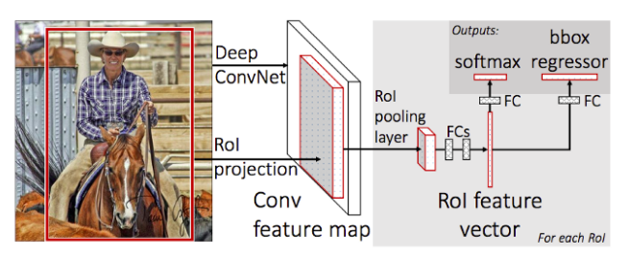
Two-Stage detectors
Fast R-CNN
Instead of feeding 2000 regions, the input image is fed to CNN to generate one feature map.
SS is running as usual, the region proposals generated are projected to the feature map.
proposals are wrapped to fixed-size squares using ROI pooling layer.
25x faster than R-CNN
ROI pooling

Slide 9
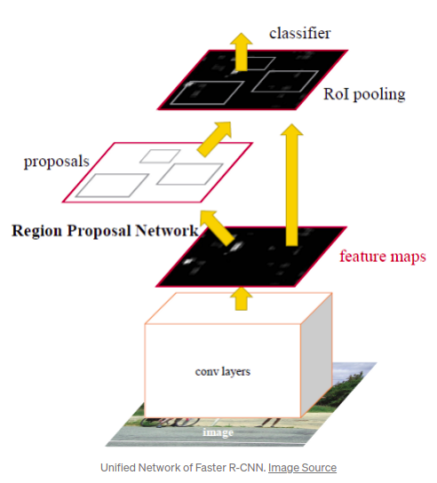
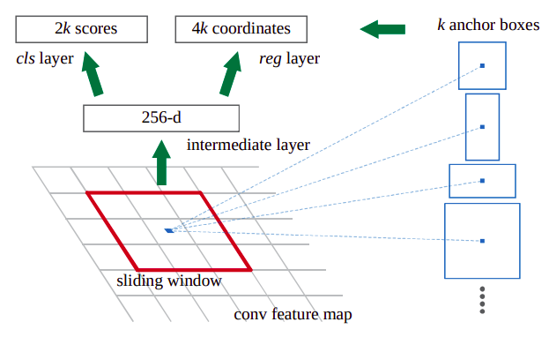
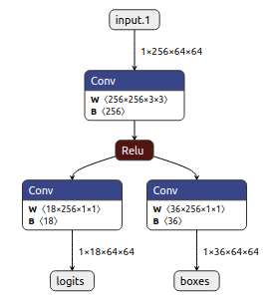
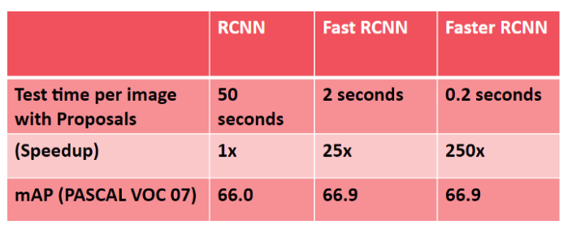
Two-Stage detectors
Faster R-CNN - RPN explained
Region Proposal Network (RPN) instead of Selective Search.
Slide over the feature map with n x n spatial window.
Each sliding window regress k bounding boxes which are compared to k reference anchor boxes.
Proposals are filtered based on their “objectness score” and nms.
k = 9

Slide 10
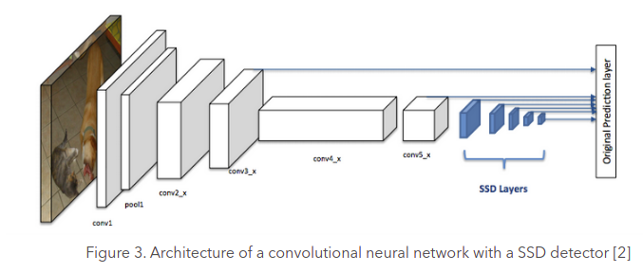
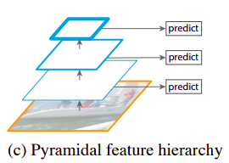
SSD - Single Shot Detection
Architecture
one-stage detector, bottom-up design.
Use base network and SSD layers to regress location and confidence from different scaled feature maps.
Feature maps from different levels are known to have different receptive field sizes.

Slide 11
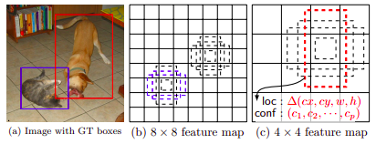
SSD - Single Shot Detection
Regression & positive assignment
SSD net output multiple feature maps, with different spatial sizes m x n.
For each position in m x n we assign k anchors with different aspect ratios. For example {1, 2, 3, ½, ⅓}
For each feature maps anchors regress:
cx, cy offset from anchor center position.
w, h size of box.
sc classification score for the cth class.
In total for a single feature map:
num of anchors: k x m x n
regress for each anchor: c + 4
An anchor is considered as positive if IOU > 0.5.

Slide 12
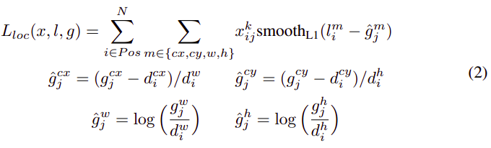

SSD - Single Shot Detection
Losses
xij {0, 1} match between i box to j gt box..
N num of positive boxes.
l predicted box.
g ground-truth box
d default-box (anchor)
Hard Mining of Top negative samples, 3:1 ratio negatives:positives.

Slide 13
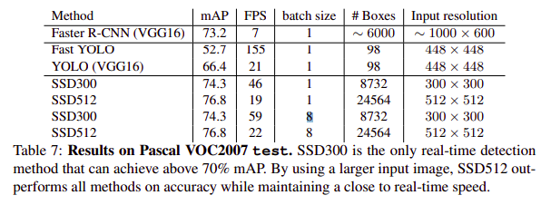
SSD - Single Shot Detection
Experimental results
Pro’s:
Fast
Con’s:
Low accuracy on small objects, due to low resolution feature maps.
Hyper-parameters configurations: aspect ratios.
Change in input size lead to change in pre-defined anchors.

Slide 14
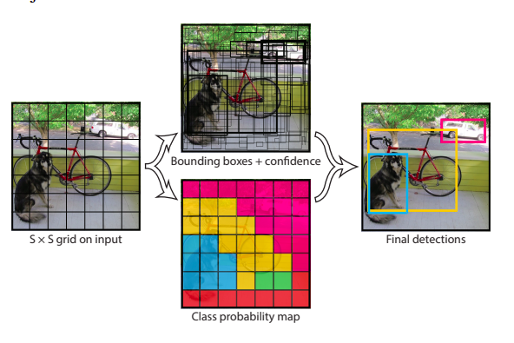

YOLO
Divide the input image to S x S grid, grid cell is responsible to the detect an object if it center falls in it.
Each cell predicts B bounding boxes, regressing x,y,w,h and confidence which represent the IOU between predicted box and ground truth box.
Each cell also predicts C conditional class probabilities
In total YOLO predicts:

Slide 15
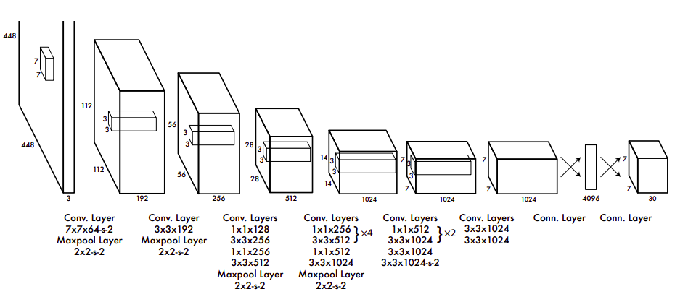
YOLO
GoogleNet backbone, with 24 conv layers, followed by 2 fully connected layers

Slide 16
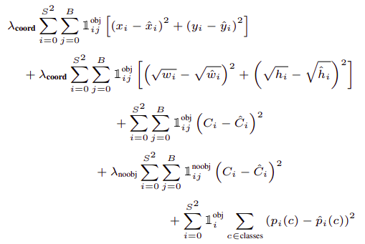



YOLO
Partially address contribution of large vs. small boxes predicting square root of sizes.
Background / foreground imbalance.
- object appears in cell i.
- predictor is “responsible” for that prediction, meaning have highest IOU with g-t.

Slide 17
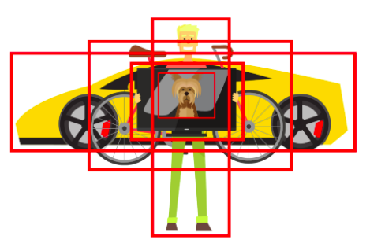
YOLOv2
Yolo v1 has several limitations:
Detection of nearby objects.
Detection of small objects.
Bad localization in small boxes.
Low recall compared to Two-stage detectors.
Yolo v2 - focus on improving recall and localization:
Batch normalization: 2% improvement in mAP.
Multi-scale training {320 to 608}, predicts objects in different resolutions.
Using anchor boxes. Better recall but drops in precision.
Darknet-19 as backbone.

Slide 18
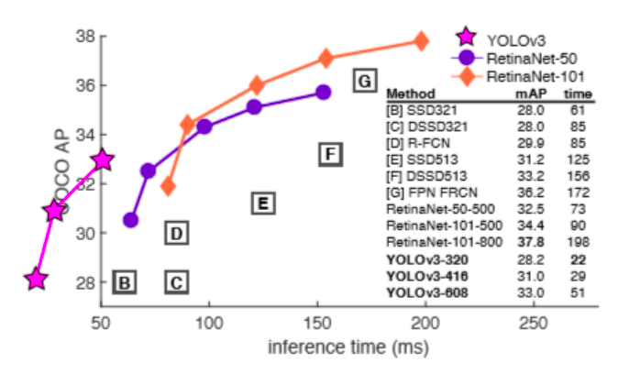
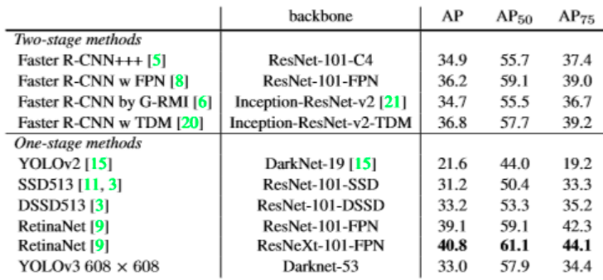
YOLOv3
Bigger and more accurate:
Multi labels prediction: object have multiple labels (woman:person), using binary cross-entropy instead of softmax.
Short-cut connections: more finer-grained information from earlier feature maps. improve detection of small objects.
perform less than previous version with medium and large-size objects.
Darknet-53 as backbone, with residual connections.
Predict boxes at 3 different scales. (one scale for YOLOv2).
Still perform poorly to regress localization well (AP75).

Slide 19
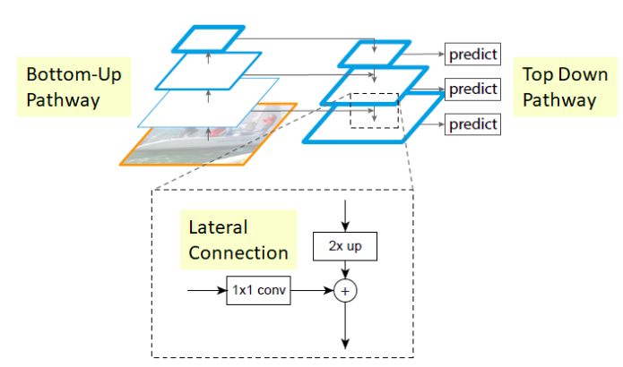
FPN
Combines low-resolution, semantically strong features with high-resolution semantically weak features via a top-down pathway and lateral connections.
This process is independent of the backbone, and can used with RPN detector (Faster R-CNN), anchor based detectors (RetinaNet) and widely used for almost all anchor free detectors (FCOS, CornerNet, CenterNet).
This method achieve the best results compared to other multi-scale feature maps heads, such as, SSD and YOLOv3.

Slide 20
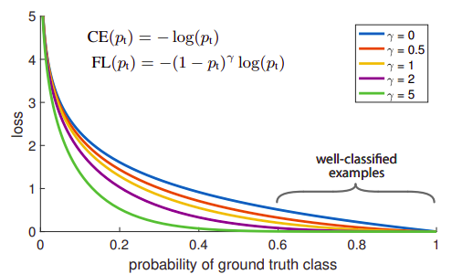
RetinaNet - Focal loss
reduce contribution of well-classified (easy) samples

Slide 21
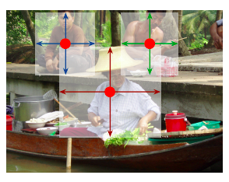
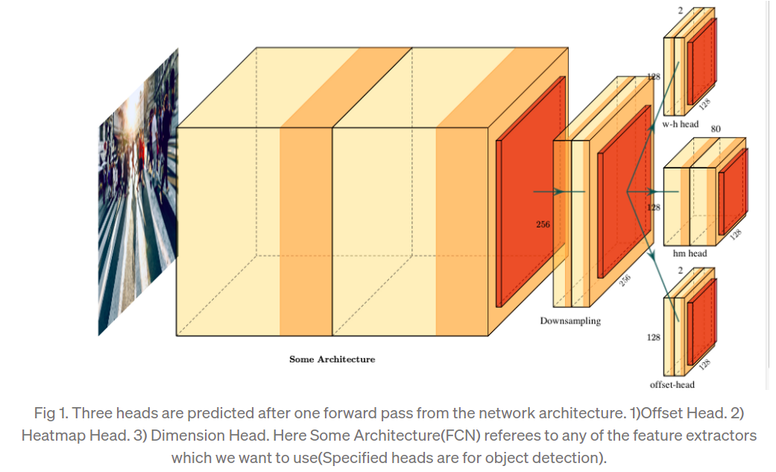
CenterNet - anchor free
Anchor free center-based approach.
CenterNet consider center of a box as an object, and then uses this predicted center to find the the scales / offsets of the box.
Paper presents that their method can be extended easily to other tasks:
3D detection
Human pose estimation

Slide 22
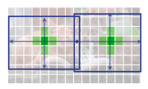
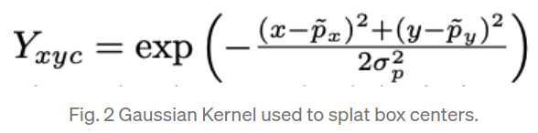
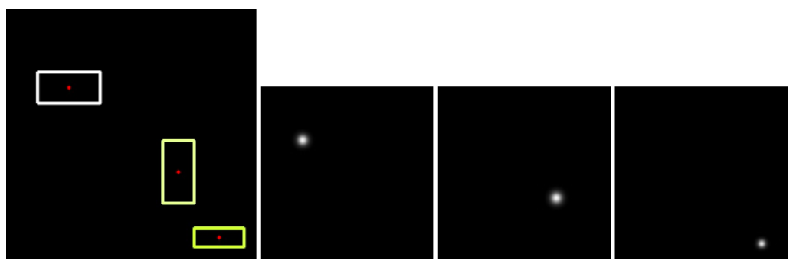
Positives assignment
Each ground truth box center is interpreted to a center in the strided heatmap, surrounded by a gaussian gradient.
Size of gradient depends on the ground-truth box size.
Different heatmaps for each class.

Slide 23
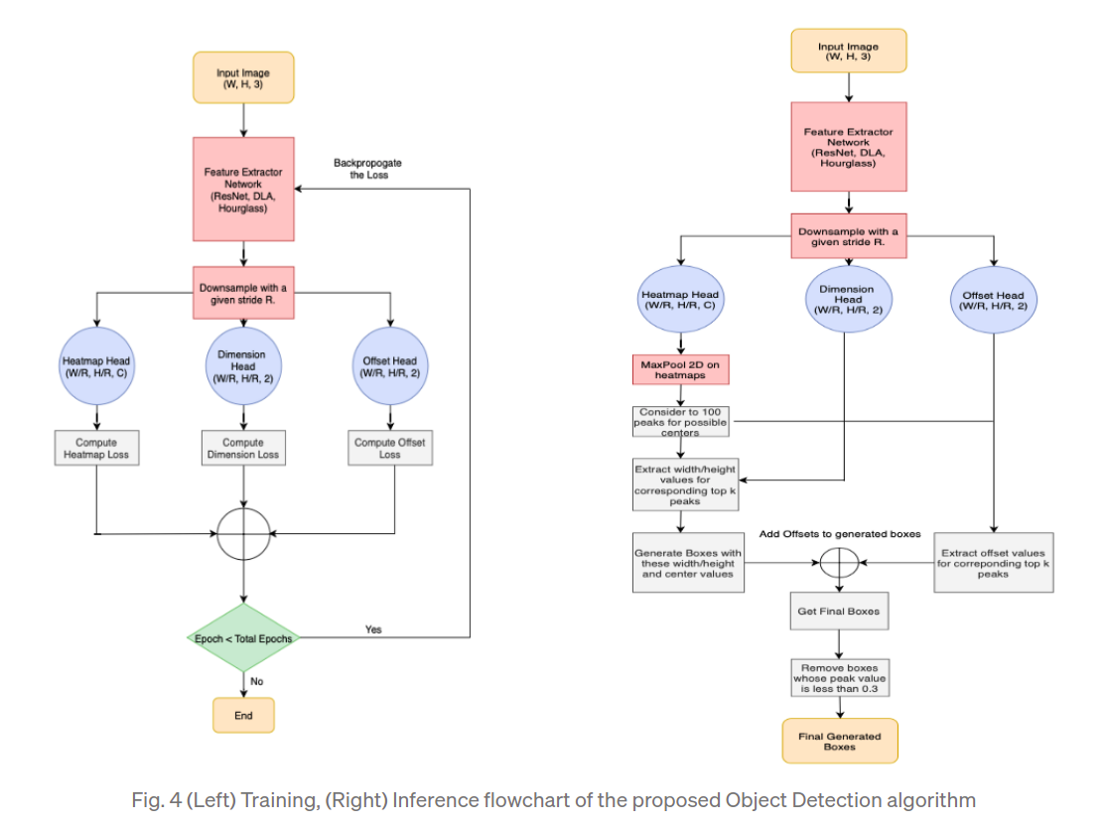

Slide 24
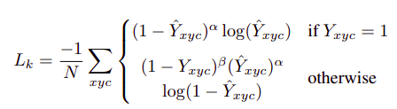



Losses
Heatmap variant Focal loss:
Add negative weights.
Offset localization loss:
Positive centers
Object sizes loss:

Slide 25
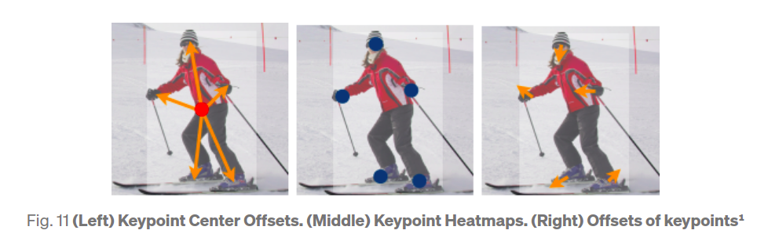
Human Pose estimation - keypoints
These strided maps with sizes {W/R, H/R} are regressed additionally for k points:
k x 2 for x,y offsets from object center point.
k heatmaps for keypoints centers.
k x 2 x,y offsets from k heatmaps centers.

Slide 26
Why Anchor free?
Avoid all hyper-parameters related to anchor boxes, which are very sensitive to the final performance. (sizes, aspect ratios and number of anchors)
Anchor based method has excessive number of samples (k times anchor-free centers), most of them are background samples which aggravates the imbalance between positive and negative samples.
Eliminating pre-defined anchor boxes, adjust well to different input sizes.

